Slide 1

I’M THE DOC
SELF DIAGNOSIS TOOLKIT
Submitted in partial fulfilment of the
requirement for the award of the degree
of
Bachelor of Technology
in
Computer Science & Engineering
By:
Shivam Arora (008/CSE 1/2014)
Puneetjyot Singh (007/CSE 1/2014)
Sukhleen Kaur (011/CSE 1/2014)
Bhumika Kaur (064/CSE 1/2014)
Under the guidance of:
Mr. Aashish Bhardwaj

Slide 2

PROBLEM
When you're feeling under the weather do you rush to the hospital? Google frantically?
The results that come are very likely to be misleading, giving you a feeling that you have a deadly disease which you may even not have it.
So, it is very likely that you don’t get an accurate diagnosis.

Slide 3

THE IDEA!!!
To avoid such scenarios, we got the idea to provide a middle ground solution which helps you understand your symptoms with the ease of a web-app.
The application doesn't intend to replace a doctor but rather to inform the patients and make them more aware.

Slide 4
OBJECTIVE
To develop a web-app to aid self-diagnosis for individuals worried that something might be amiss.
Our main focus is on the following features:
it's simple to use
provides accurate results without the use of any extra devices or sensors
informative on different medical conditions
uses friendly graphical user interface
offers a variety of tools for self-diagnosis

Slide 5
THE APPLICATION
A toolkit merely to help you understand what exactly is going on with your body by giving you more knowledge about it
It offers the guidance of medical professionals with the ease of a web-app
When you use I’m The Doc, you analyse your symptoms and make possible diagnosis for some common diseases.

Slide 6
FEATURES OF I’M THE DOC
Visual Pulse Monitoring
Detection of Jaundice from the colour of the eyes:
Pure tone audiometry (PTA) Test

Slide 7

1. Visual Pulse Monitoring
Capture images of the finger while your finger is kept in front of the flash and the blood coursing in through the arteries can be seen.
Counting the transitions in the blood every time there is a slight blink or dip in the intensity of light gives a raw estimate of the heart rate.

Slide 8
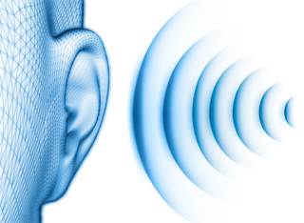
2. Pure tone audiometry (PTA) Test
Sounds of different frequencies are used and they are played on the speaker of the phone.
In case the user can listen to the sound, he presses a yes and in case the user is not able to hear it, he says no.
Results are plotted onto graphs and if for a particular threshold

Slide 9
DEMO OF ABOVE 2 TOOLS

Slide 10
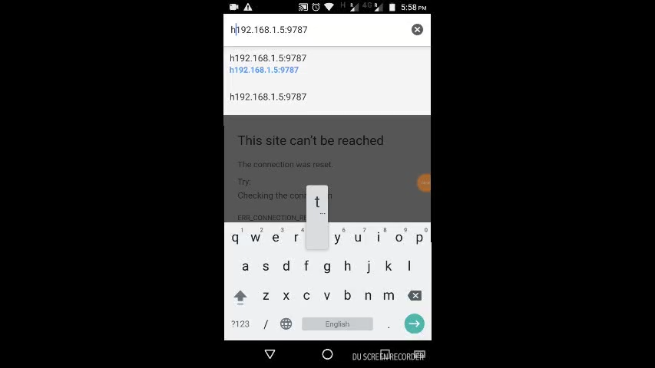

Slide 11
3. Detection of Jaundice
It extracts the different features of the face. The app would extract only the eyes and pass it to our model.
Using Image Processing Libraries and Open CV, we created a tool which can accurately predict if the person has Jaundice or not.

Slide 12
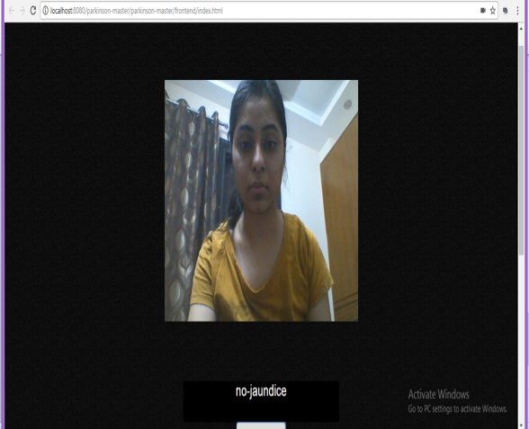
JAUNDICE DETECTION TECHNIQUE
Using an already trained regression model, it extracts the different features of the face.
The app would extract only the eyes and pass it to our model.

Slide 13
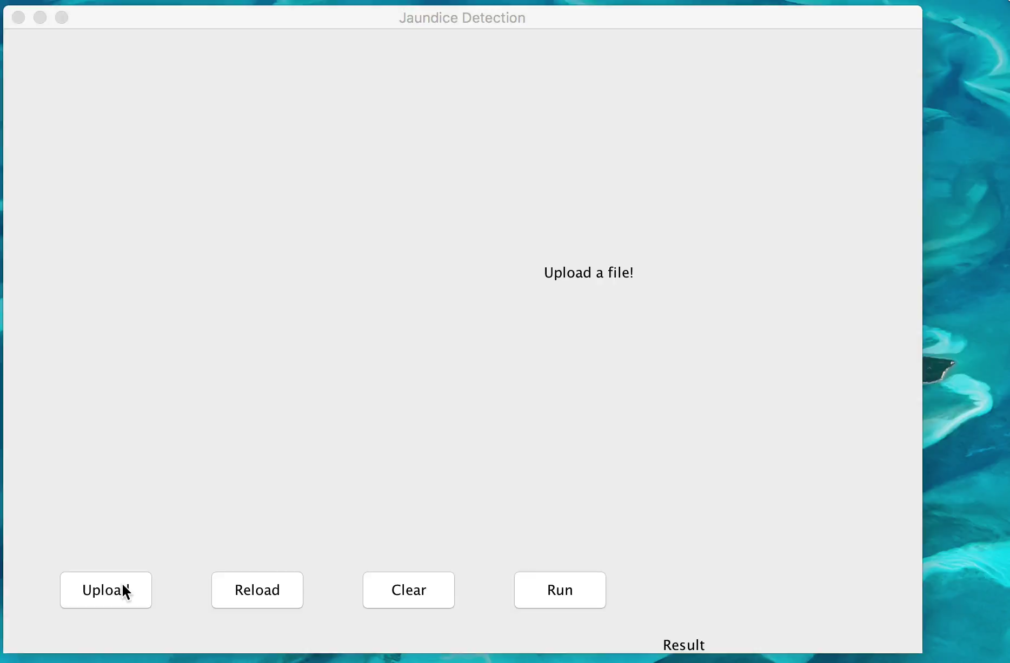
DEMO OF JAUNDICE DETECTION

Slide 14
CONCLUSION
In this project, we studied the different approaches used for mobile devices to extract heart rate measurements of individuals. The application that we selected used an approach of analysing human skin tone variations using the built-in camera of the phone.
It extracts the different features of the face and pass it to the model. Using Image Processing Libraries and OpenCV, we created a tool which can predict if the person has Jaundice or not.
We devised an application to test the hearing ability of children as well as adults with a very simple but informative test.

Slide 15
THANKYOU!!!!!!
Any Questions?

